Slide 1
DSBA 6100 Project Proposal – Group 5 Feb 3rd 2020
Tony Bejos
Matthew Flynn
Shivani Gupta
Robbie Reed
Tanya Mendes

Slide 2

Emerald Green Inc.
Professional lawn care and landscaping service located in Whitsett, North Carolina
Established in 1999
A wide-range of services: lawn care, landscaping, aeration, seeding, shrub care, tick control
Loyal customer base
Notes:
Tony B

Slide 3




What Are We Helping Emerald Green Inc. Achieve?
Customer Segmentation
Customer demographics, most used products, ideal customer
New Customer Targeting
Most profitable customer/product
Notes:
Customer Segmentation 1st, Targeting 2nd
Shivani

Slide 4




Dataset Characteristics
CUSTOMER BASE: 1,100 active
DATA SOURCE:
CRM software
SERVICE ASSISTANT
HISTORY:
200,000 rows + of data since 2009
DATA GRAIN:
Services used by customer by estimate date
Notes:
CRM - Customer resource management software, data warehouse and reporting tool from Service Assistant
Management tool, transactions manually loaded on a daily basis. Invoices scanned in daily
Table exported is customer report by service provided
Exported in XLSX format and will be stored in MYSQL database

Slide 5



Data Analysis Strategy
Descriptive Analytics
Product profitability
-Product characteristics
-Seasonality
Customer demographics
-Customer profitability
Predictive Analytics
Forecast campaign-driven customer acquisition
Prescriptive Analytics
Recommendations for customer targeting based on profitability analysis

Slide 6
Key Performance Indicators
Meeting new customer acquisition target
Increase in subscription of ‘most profitable product’
Customer retention
Minimize the churn of new clients acquired
Notes:
Robbie

Slide 7
Group 5 - Phase 2

Slide 8
What Are We Helping Emerald Green Inc. Achieve?
Customer Segmentation
Customer demographics, most used products, ideal customer
New Customer Targeting
Most profitable customer/product
Notes:
Customer Segmentation 1st, Targeting 2nd
Shivani

Slide 9
Dataset Collection Method
Data sourced from 3 main locations:
Service Assistant (CRM software)
Company Data
Census.gov
demographics, finance, employment, industry by zip code
Customer Survey
general customer demographics
NPS measurement

Slide 10
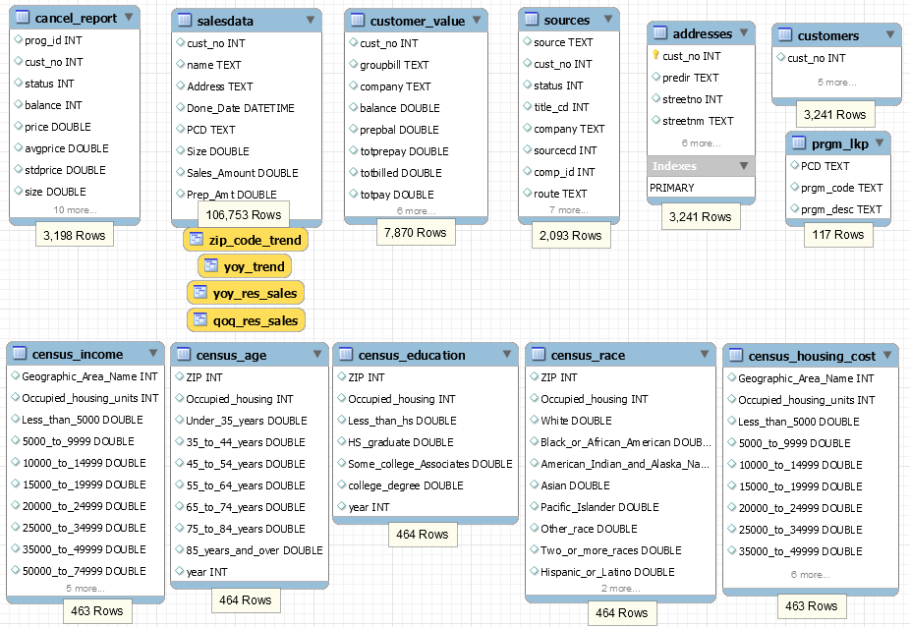
Database Characteristics

Slide 11
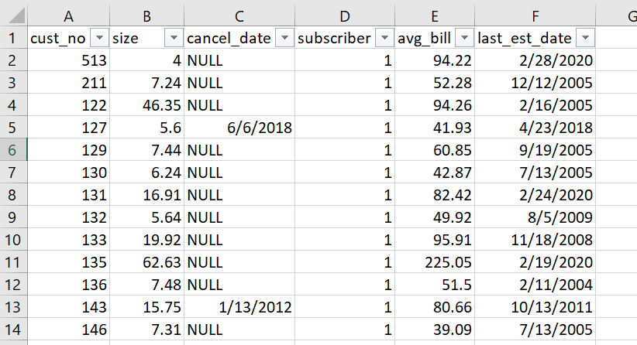
Customer Churn Analysis
The “Customers” Table:

Slide 12
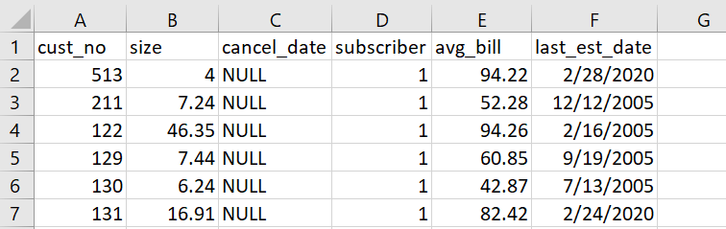
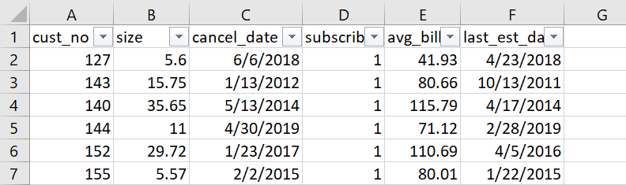
Customer Churn Analysis, Cont’d
The “Customers” Table; Segmented into Active and Cancelled:
A:
C:

Slide 13
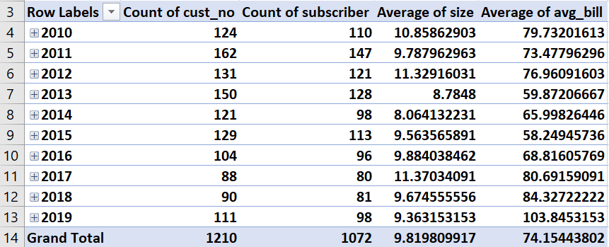
Customer Churn Analysis; Cont’d
Pivot Tables for Active and Cancelled Customers:
A:
C:

Slide 14
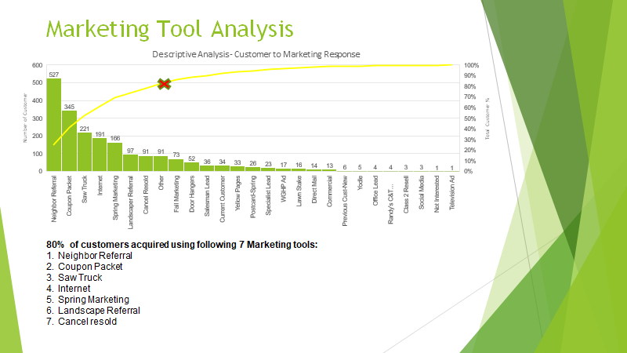

Slide 15
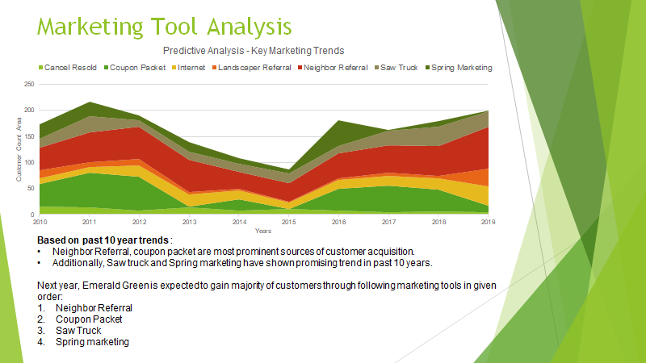

Slide 16
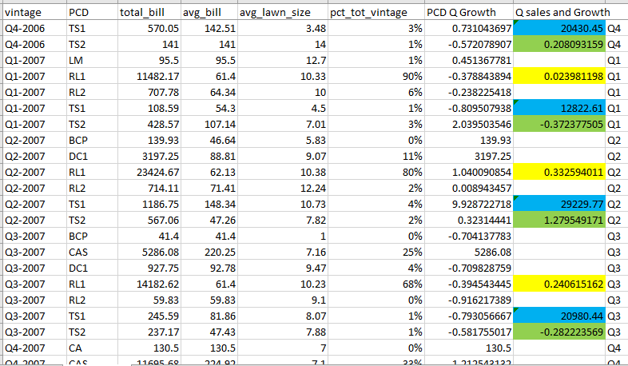
Descriptive Sales Analytics
=Total sales for the quarter
= Growth from previous quarter
=Growth from same quarter 1 year prior

Slide 17
Top performers
Q1 Q2 Q3 Q4
RL1 RL1 RL1 RL1
TS2 DC1 CAS CAS
TS1 TS2 DC1 TS2
MUL MUL TS2 TS1
RL2 TS2 TS2 TS2

Slide 18
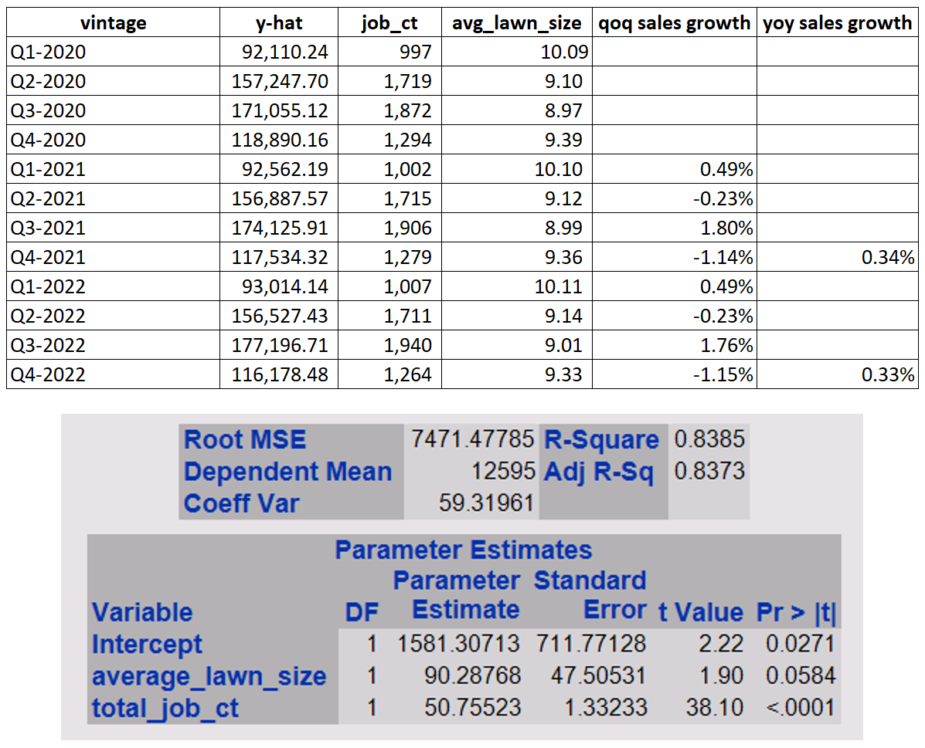
Predictive Sales Analytics
Using Linear Regression Model:
y-hat = 1581.30713 + 90.28768*job_ct + 50.75523*avg_lawn_size

Slide 19
Predictive Analytics, cont.
Next Steps:
continue to test new ind. variables to strengthen r-squared
model job count and lawn size as dependent variables
model cancels and growth as dependent variables
use all descriptive and predictive analytics to create a recommendation for target market

Slide 20
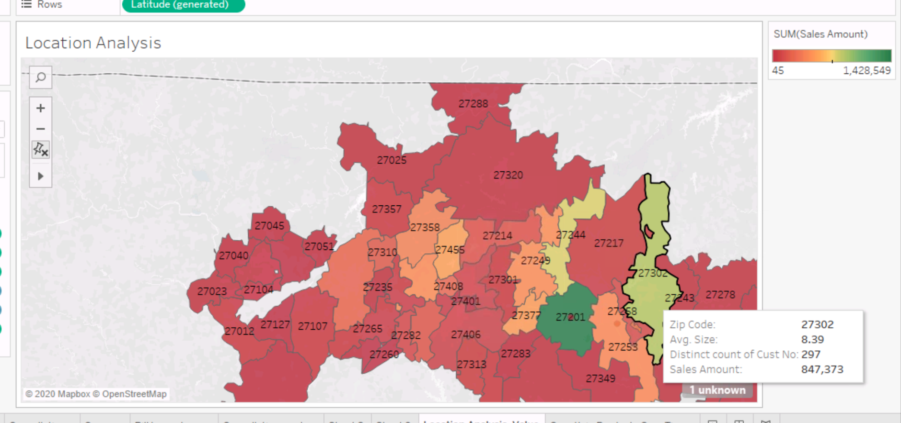
Visual Analytics - Descriptive
Profitability by zip code: sales amount, no. of customers, avg lot size

Slide 21
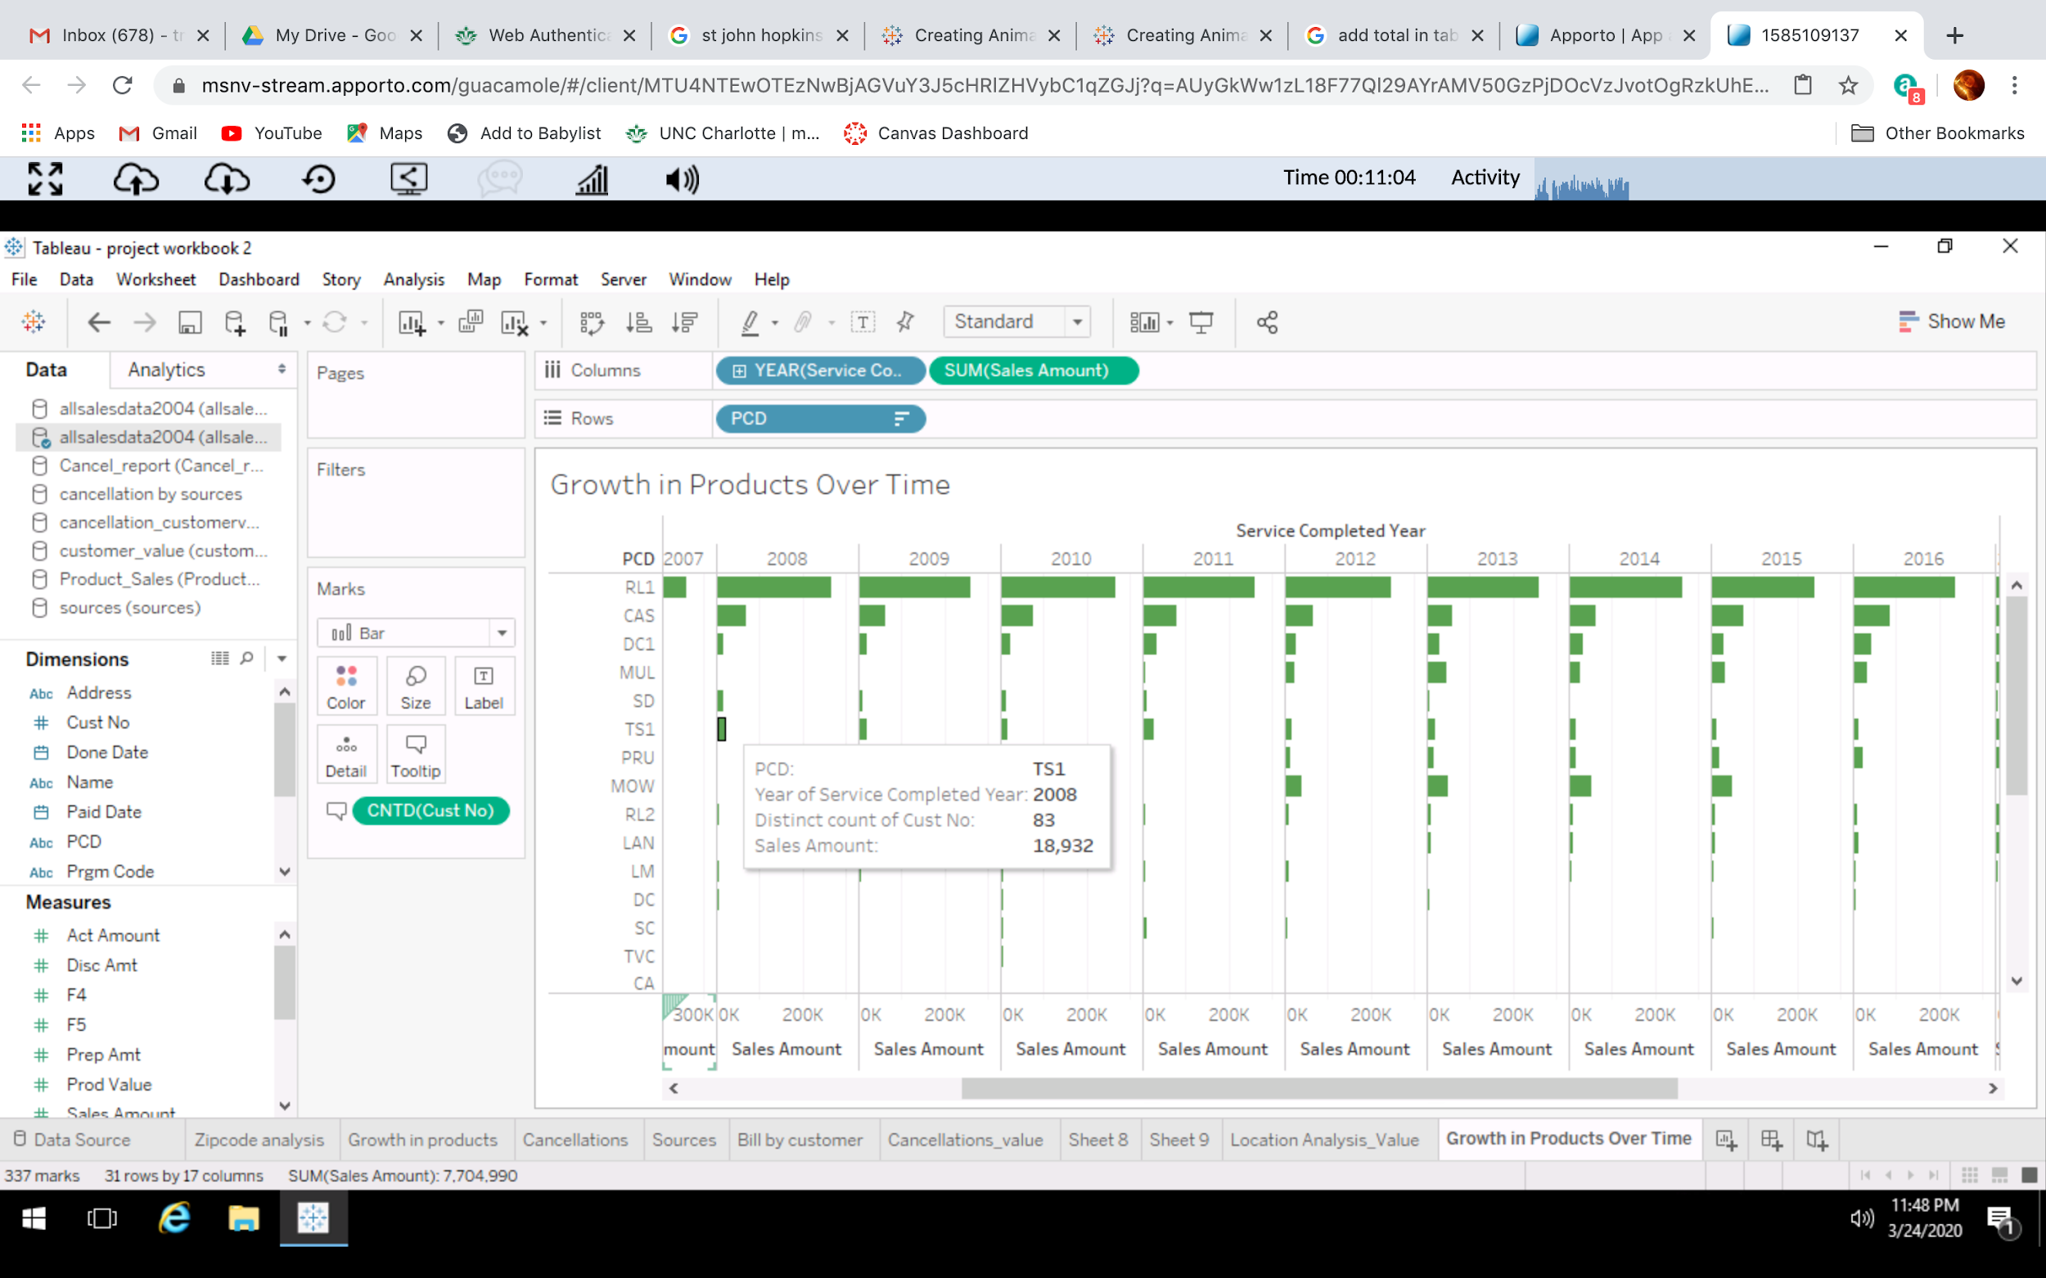
Visual Analytics - Descriptive
Growth in products over time: Sales amount by product, no. of customers

Slide 22
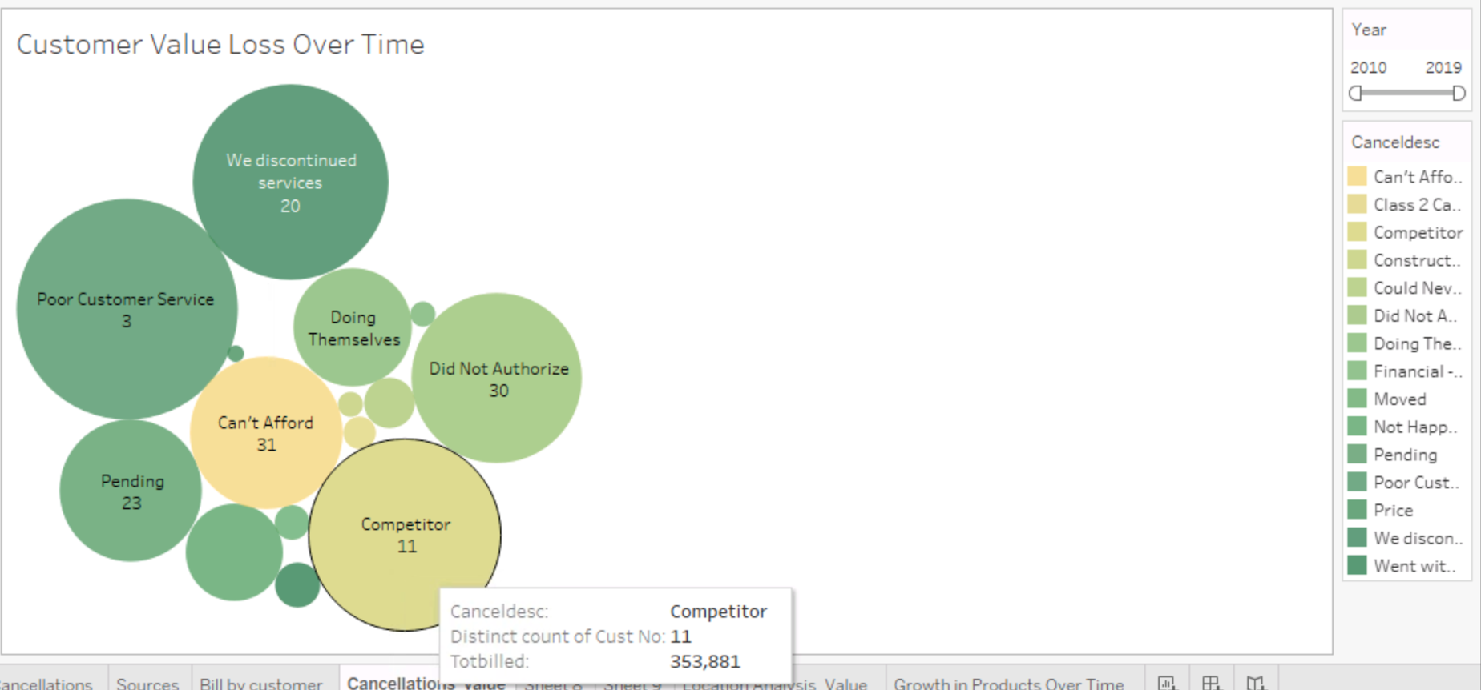
Visual Analytics - Descriptive
Cancellation reasons and value loss over time: Cancellation reason, no. of customers, total bill amount

Slide 23
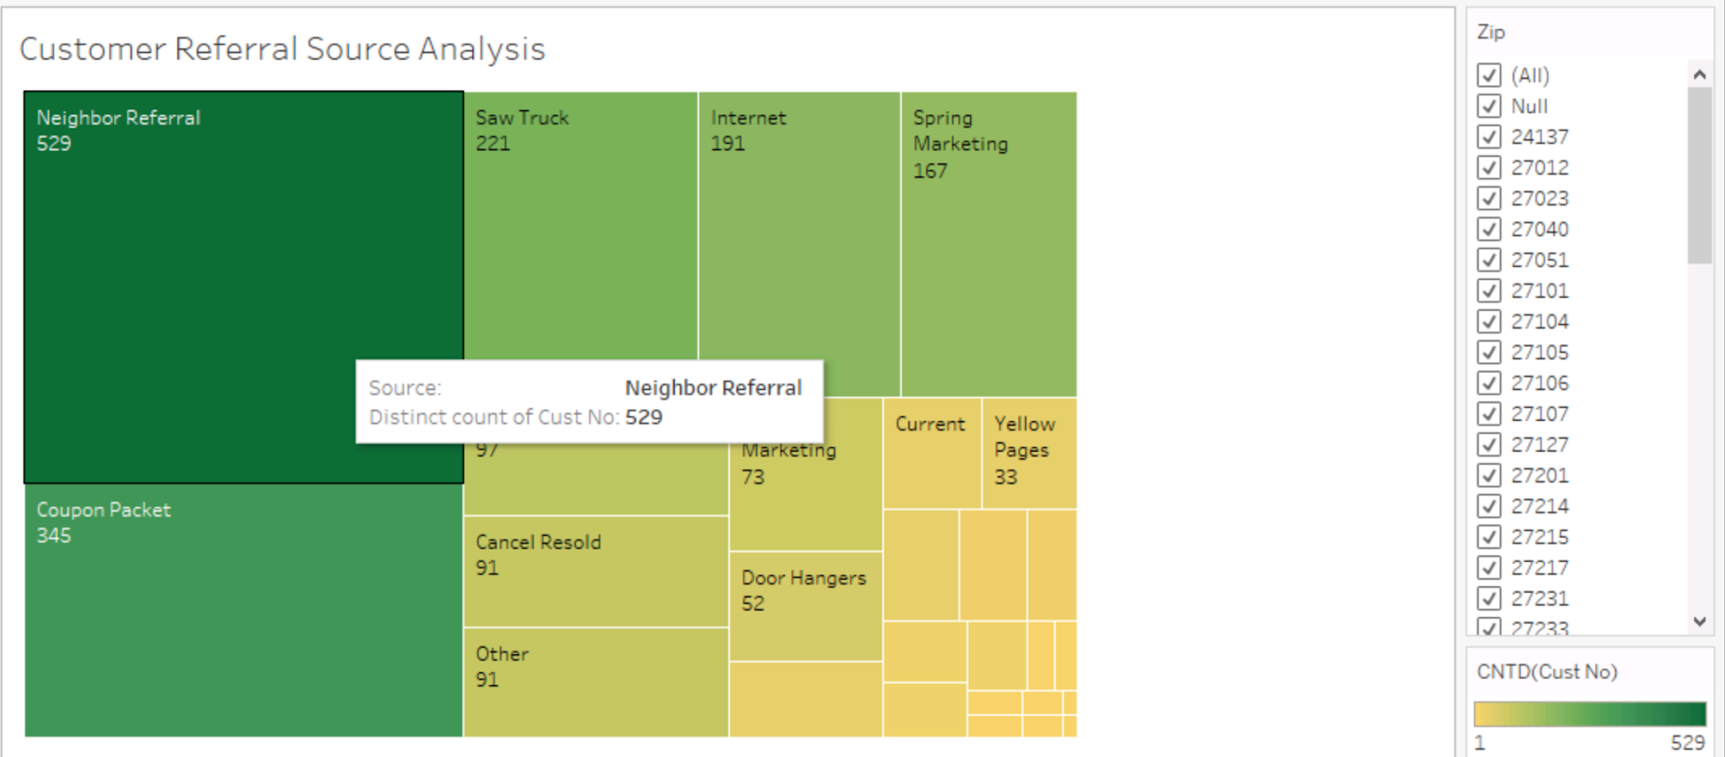
Visual Analytics - Descriptive
Referral source analysis by zip code: Referral source, no. of customers, zip code

Slide 24
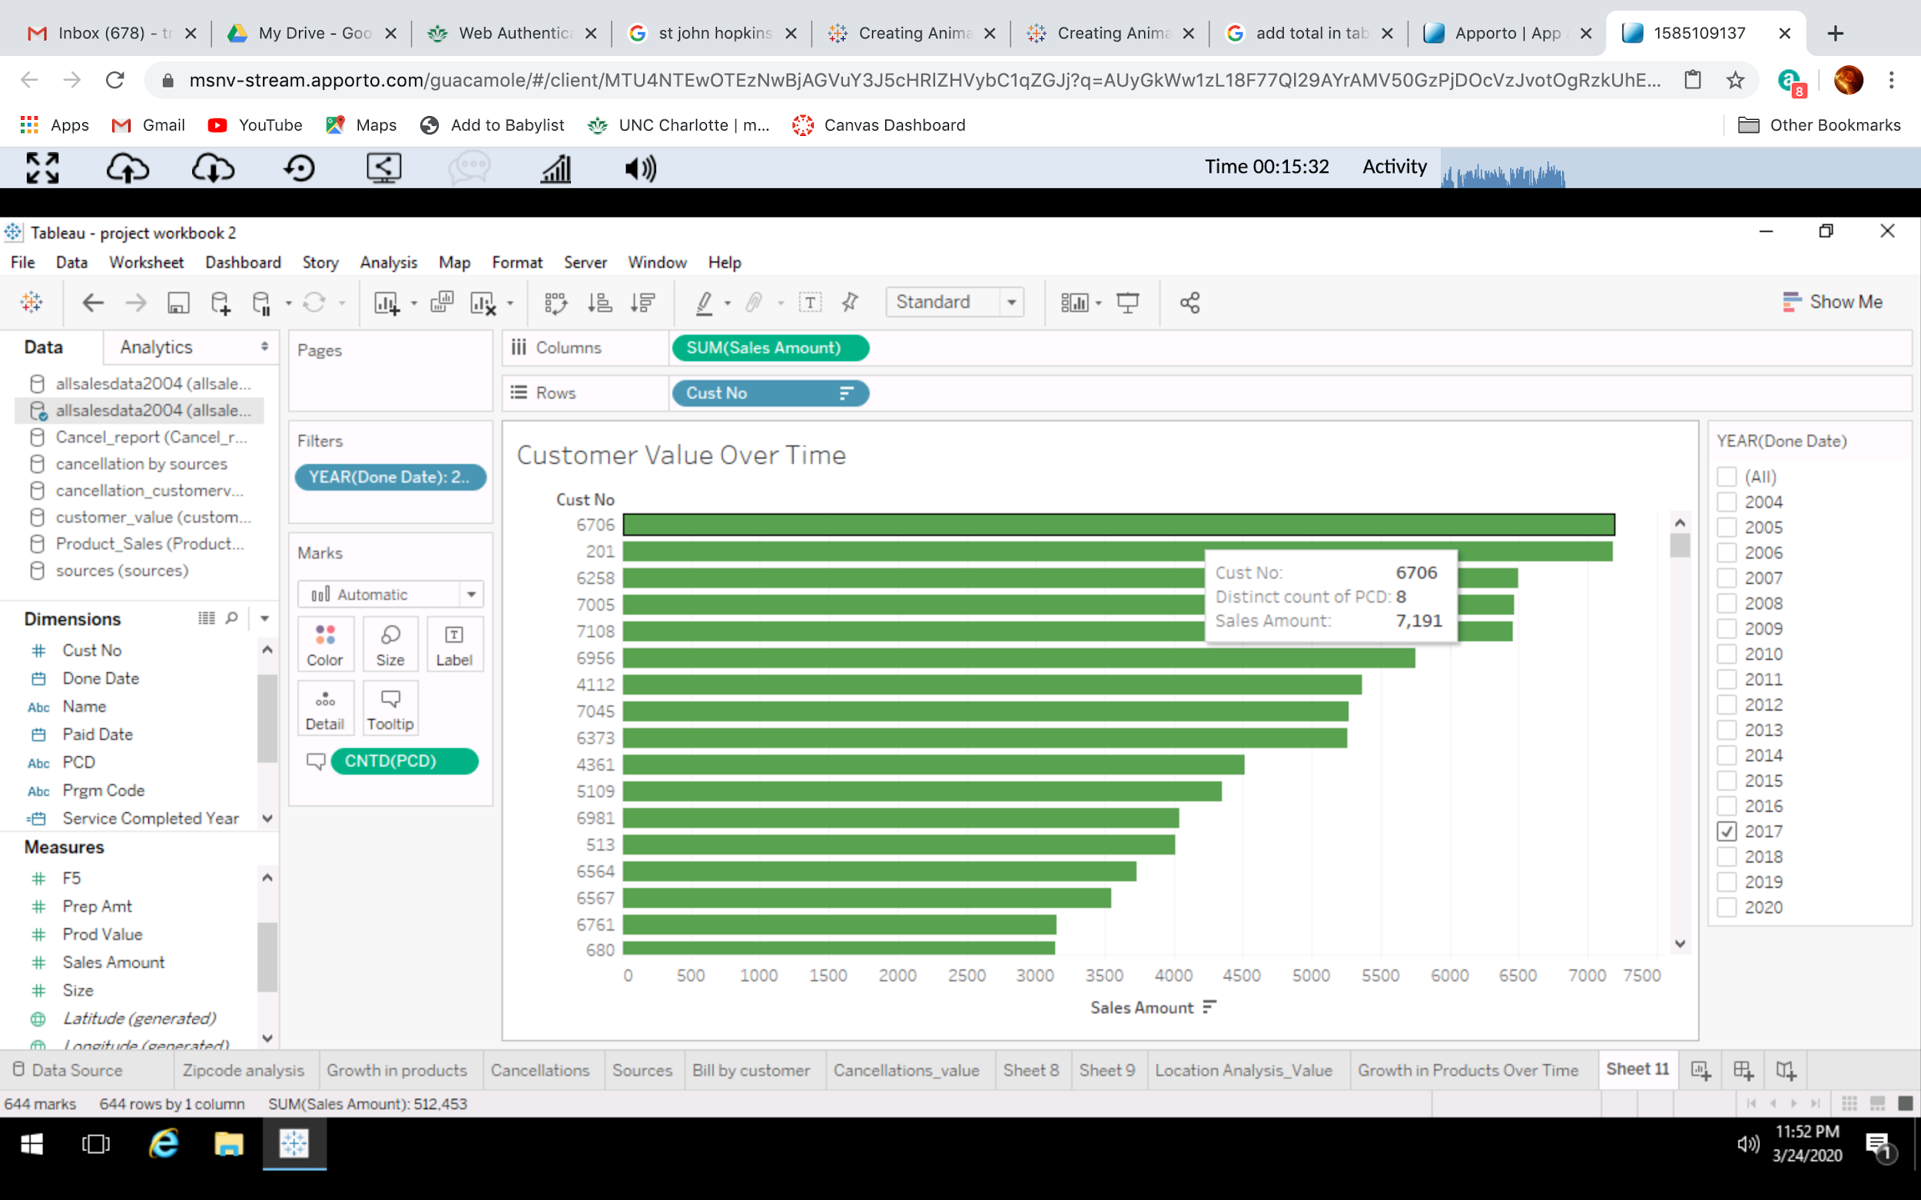
Visual Analytics - Descriptive
Customer value over time: Customer code, sales amount

Slide 25
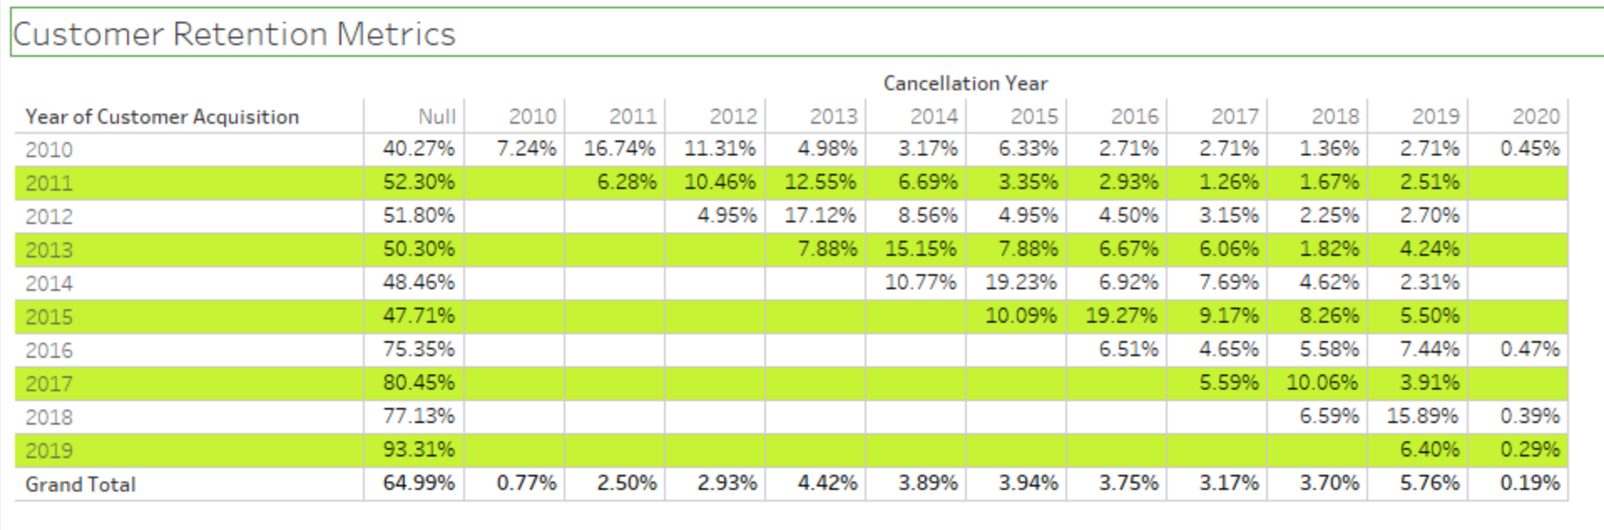
Visual Analytics - Descriptive
Customer retention metrics - Year of acquisition, cancellation year

Slide 26
Questions?

